Slide 1
Visualizing Housing Market Trends:
An Analysis of Sale Prices and Features using Tableau.
Team ID : PNT2025TMID14747Team
Size : 1
Team Leader : Shrikrishna Gawas

Slide 2

Project Overview & Data Foundation
1
2
Objective
Dataset Used
To analyze housing data and visualize trends such as house prices, age, and renovation impact using Tableau, enabling data-driven decision-making for stakeholders like real estate analysts and executives.
Source: Transformed_Housing_Data2.csv
Size: ~21,000 records
Attributes: Includes price, bedrooms, bathrooms, floors, condition, renovation year, square footage, and more.

Slide 3
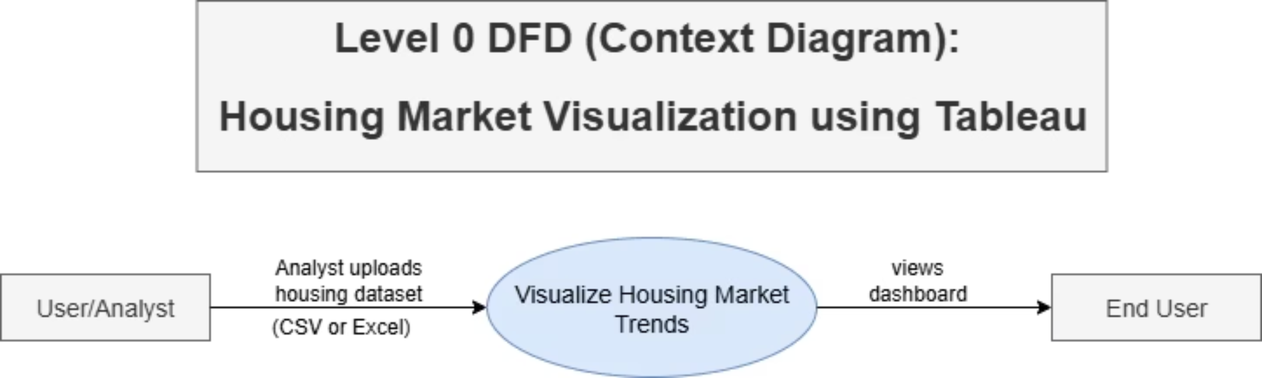
Understanding the Data Flow: DFD Level 0
The DFD Level 0 provides a high-level overview of our system, illustrating the primary interactions and data movements. It shows how raw housing data is ingested, processed, and ultimately transformed into actionable visual insights for end-users.

Slide 4
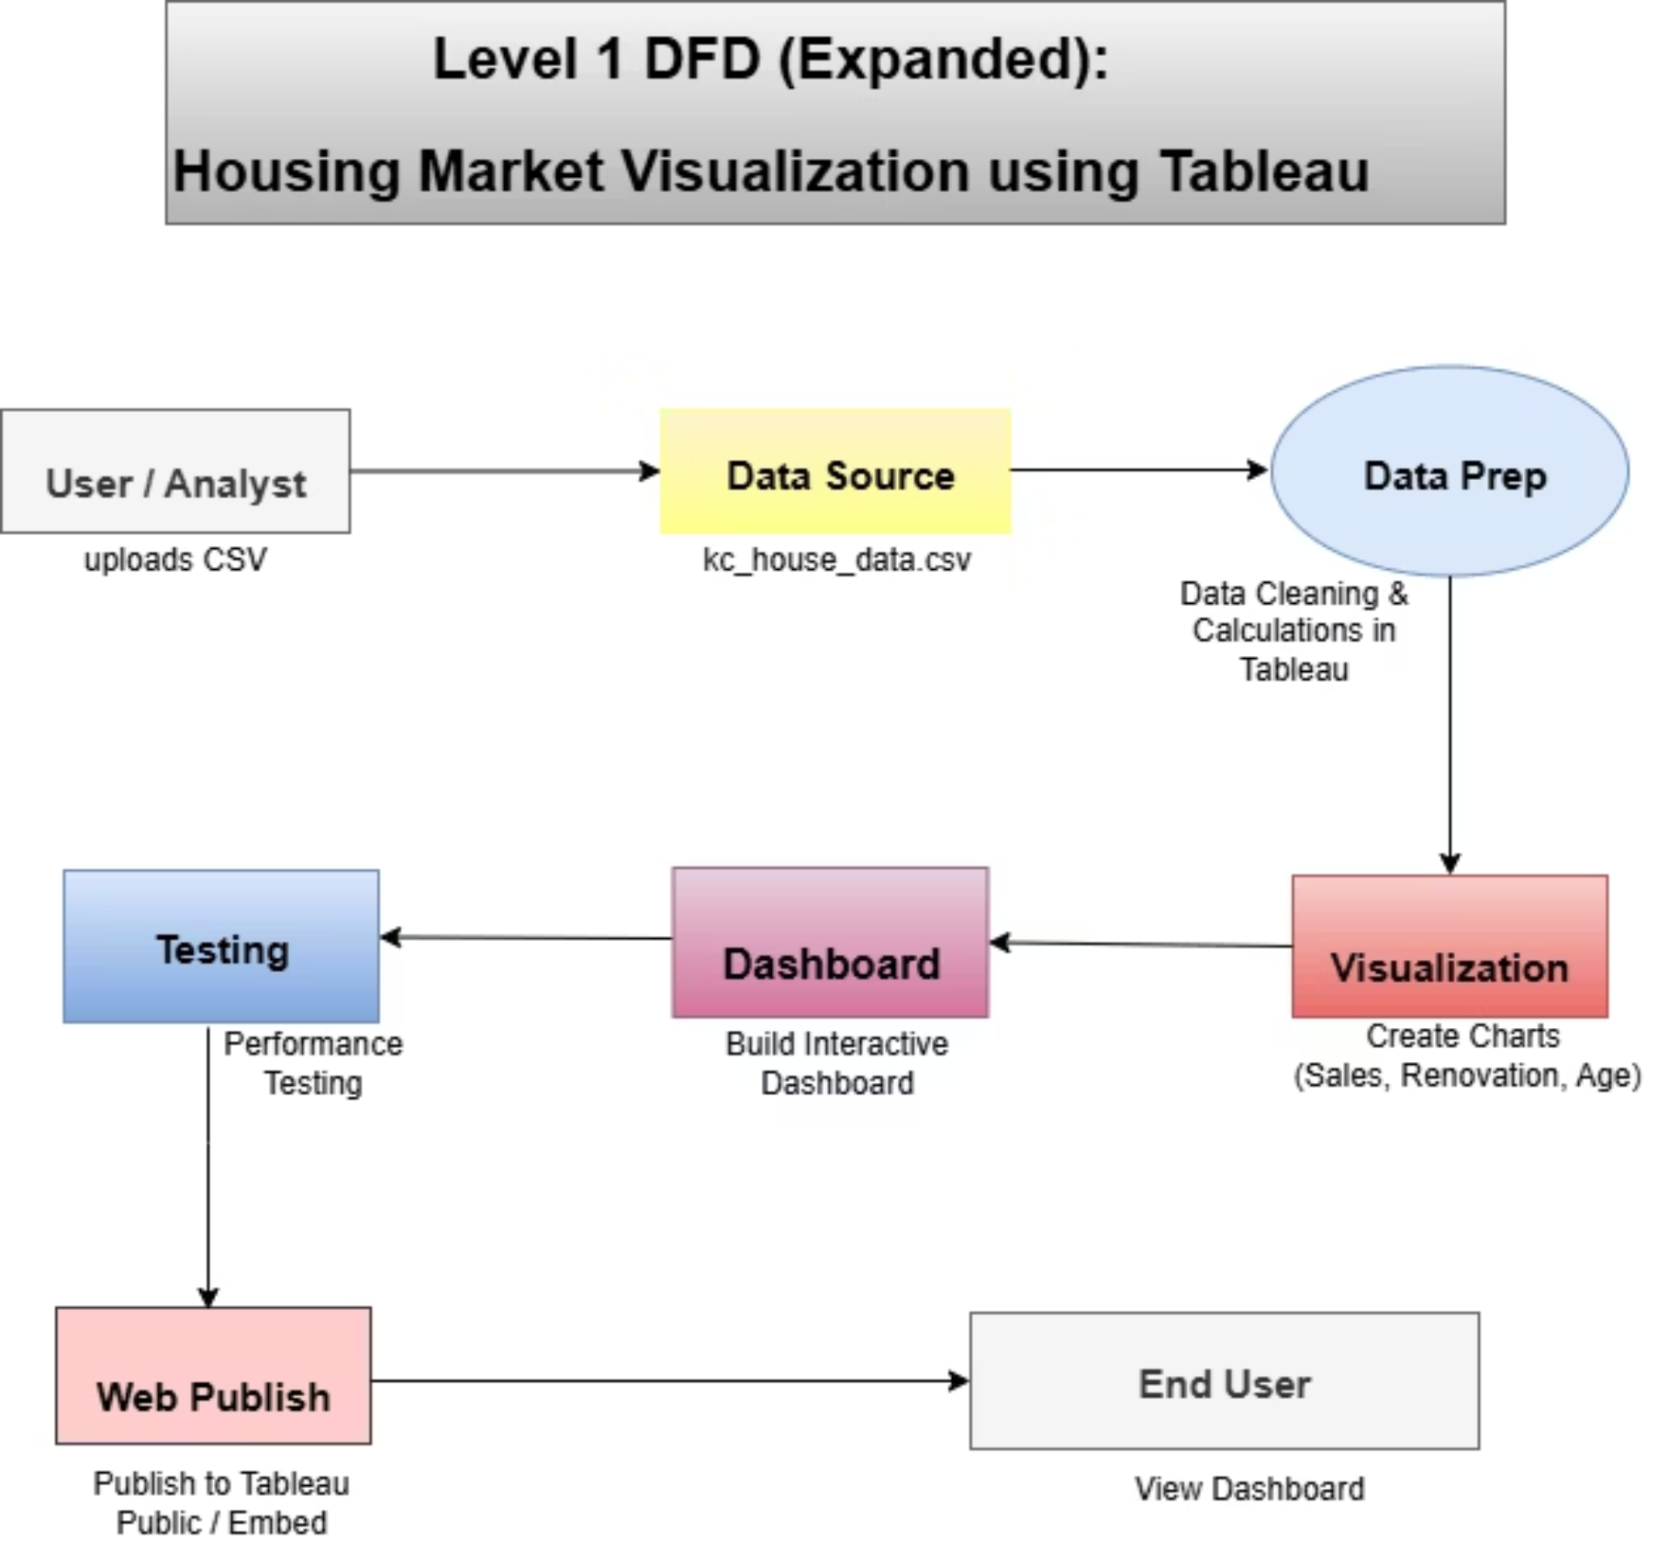
Detailed Data Processing: DFD Level 1
DFD Level 1 expands on the foundational overview, detailing each critical step in our data pipeline. From initial data upload and meticulous cleaning to visualization, dashboard creation, rigorous testing, and final publishing, this diagram illustrates our commitment to data integrity and actionable insights.

Slide 5

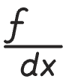


Robust Data Preparation for Accuracy
Cleaning & Standardization
Calculated Fields
Removed null values and duplicates, standardized formats for dates and numerical fields.
Created House Age (2025 - yr_built) and Years Since Renovation (2025 - yr_renovated) for deeper insights.
Clarity & Filtering
Visualization Ready
Renamed confusing columns and filtered irrelevant records (e.g., zero-bedroom houses).
Ensured data is structured and ready for meaningful Tableau visualization.

Slide 6
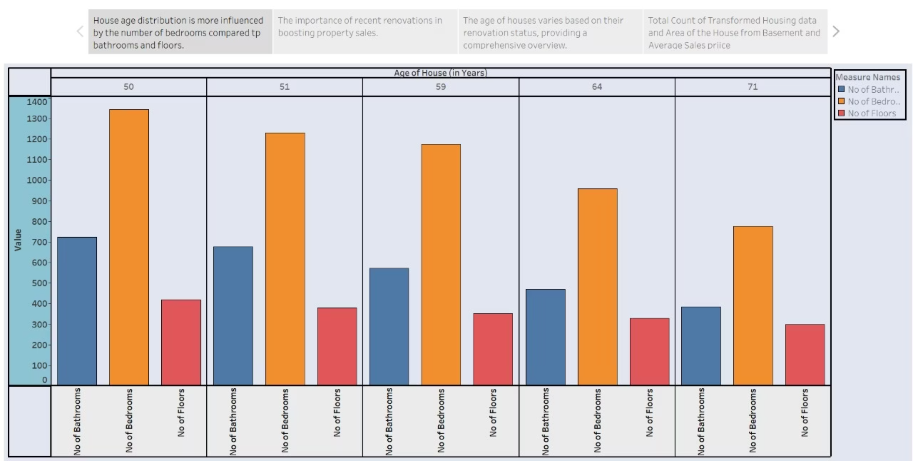
Key Visualizations: House Age vs. Features
This visualization explores the intriguing correlation between house age and key features such as the number of bathrooms, bedrooms, and floors. By highlighting which features are most influential as properties age, we can better understand market preferences and the enduring value of specific attributes.

Slide 7
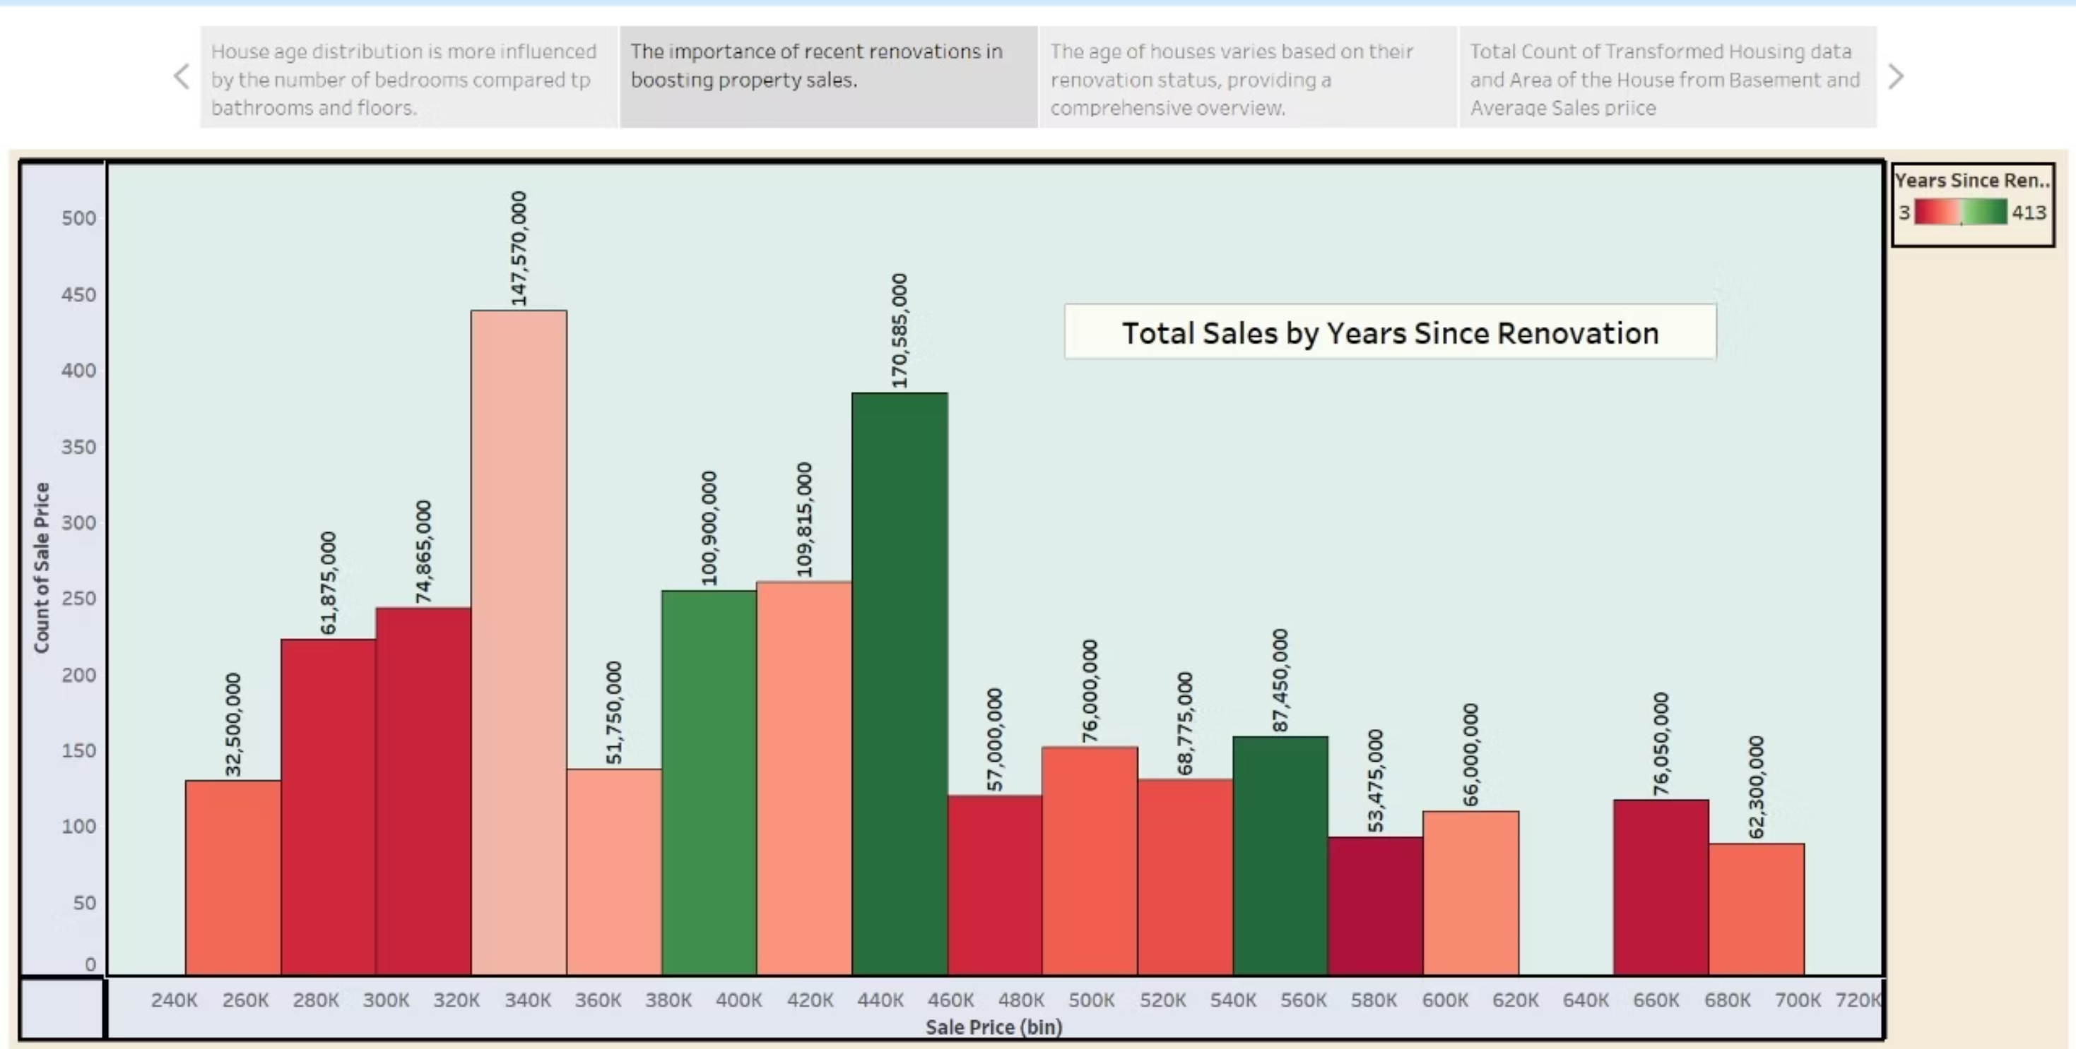
Impact of Renovation on Sales
This bar chart vividly illustrates thedirect i mpact of recent renovations on house sale prices. It clearly shows that newly renovated homes tend to achieve higher sales counts within specific price bins, underscoring the value of modern updates in the current market.

Slide 8
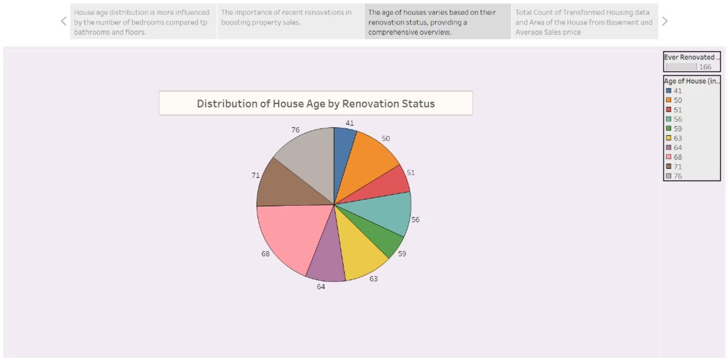
House Age Distribution by Renovation Status
This pie chart provides a clear visual breakdown of house ages, categorized by whether they have undergone renovations. This allows us to quickly identify key market trends and patterns across different age categories, revealing insights into which age groups are most frequently renovated and their proportion in the overall market.

Slide 9
Overall Dataset Summary: Key Metrics
Our analysis of the housing dataset yields compelling summary metrics, providing a foundational understanding of the market landscape. These figures offer a snapshot of the scale and average values within our comprehensive dataset.
21,609
3.8M
₹511,619
Total Data Points Analyzed
Total Basement Area (sqft)
Average Sale Price
Aggregated basement area across all properties.
The mean sale price of properties in the dataset.

Slide 10
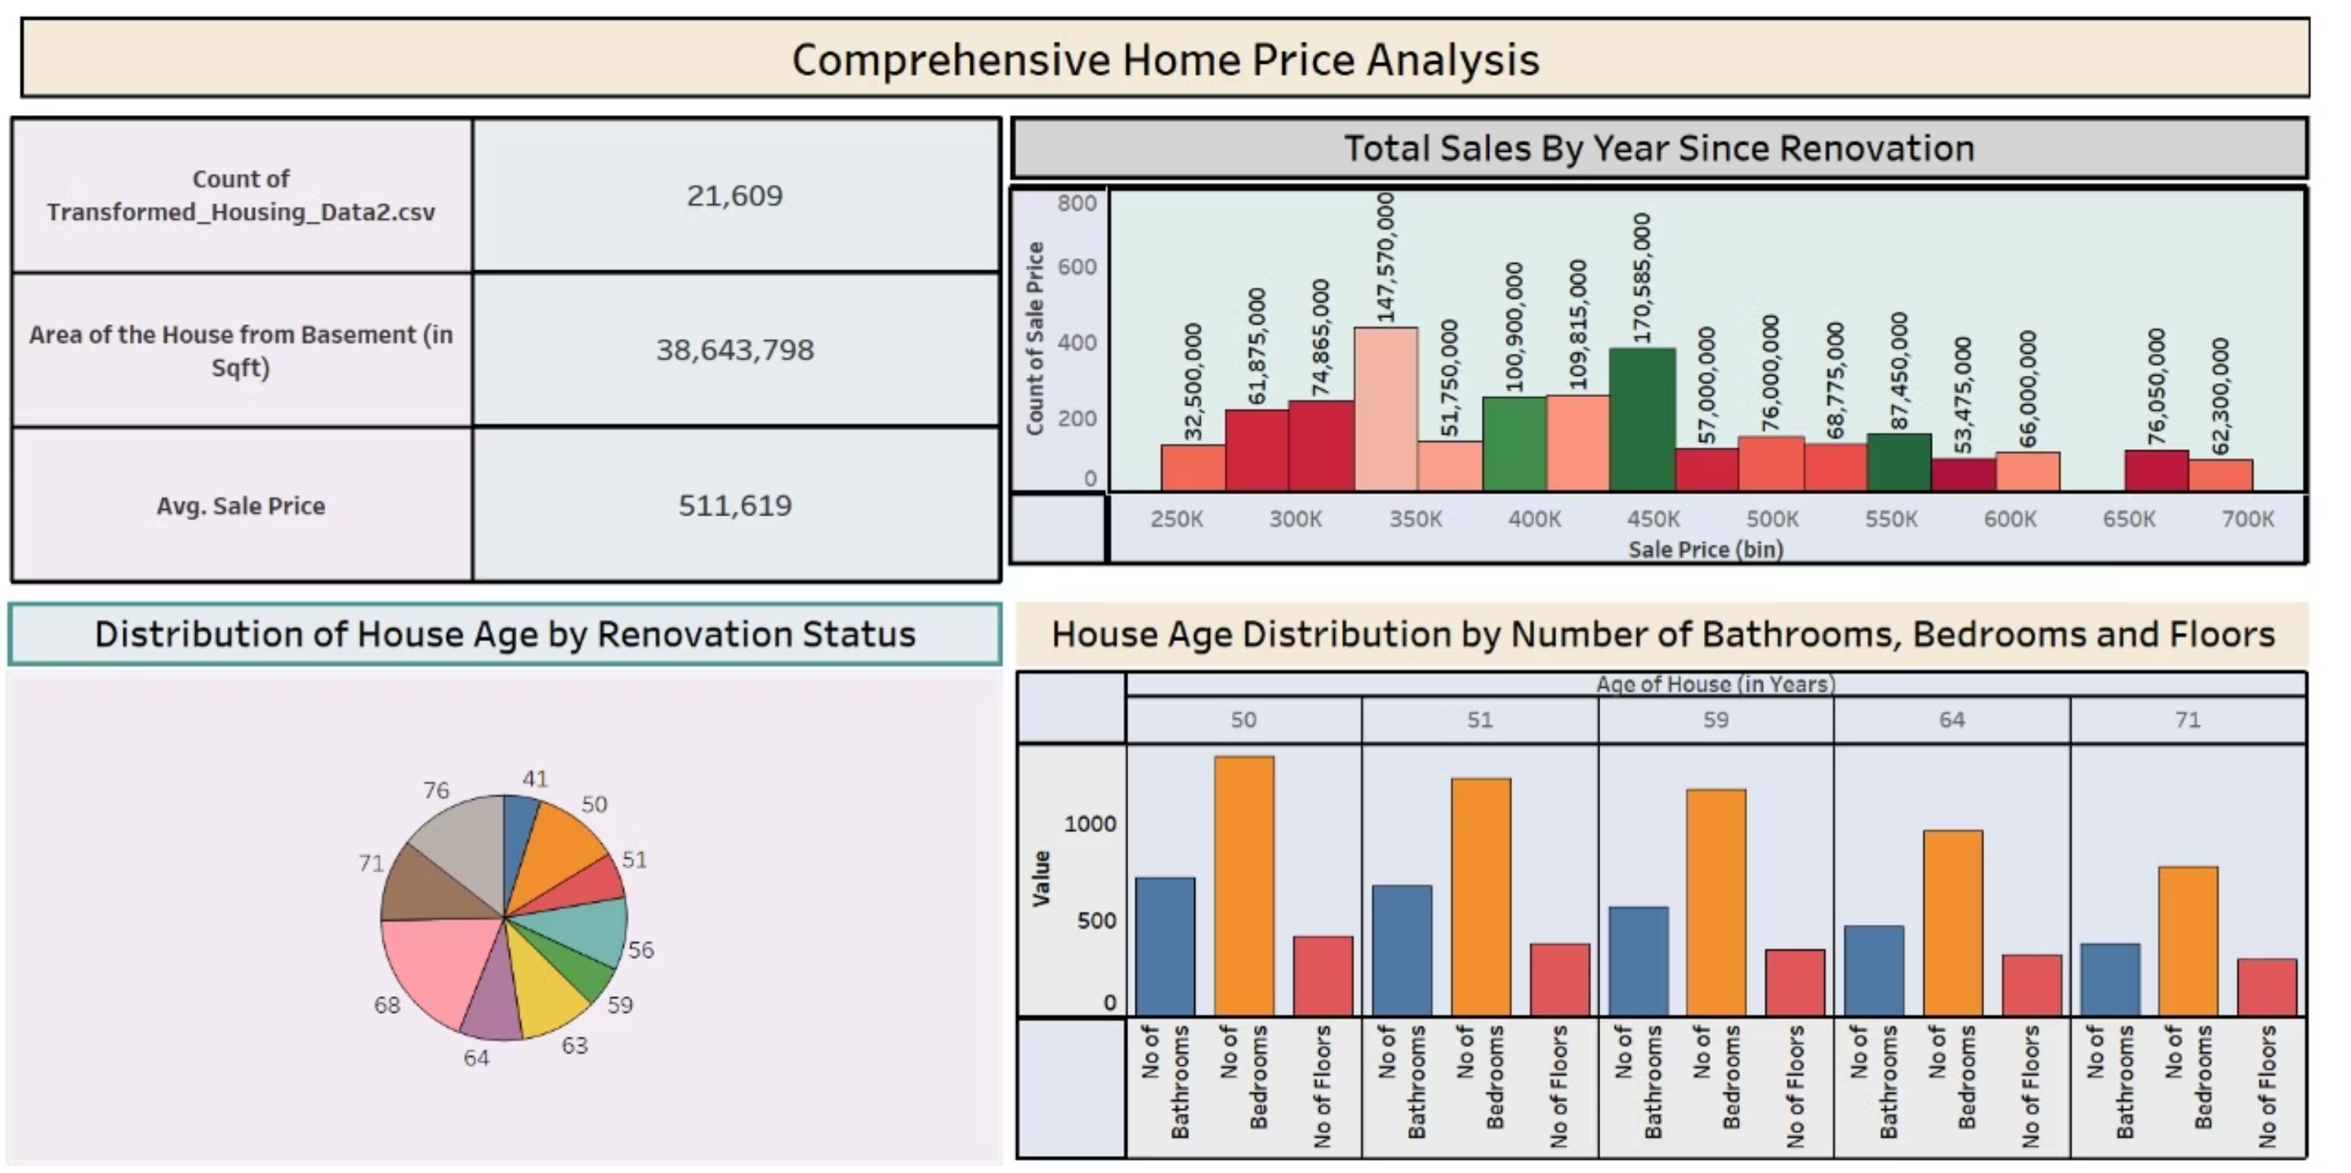
Interactive Dashboard Overview
The culmination of our analysis is this interactive Tableau dashboard. It integrates all key visualizations, allowing users to dynamically filter data, explore trends, and gain deeper, customizable insights into the housing market. This serves as a powerful tool for real estate professionals.

